Slide 1

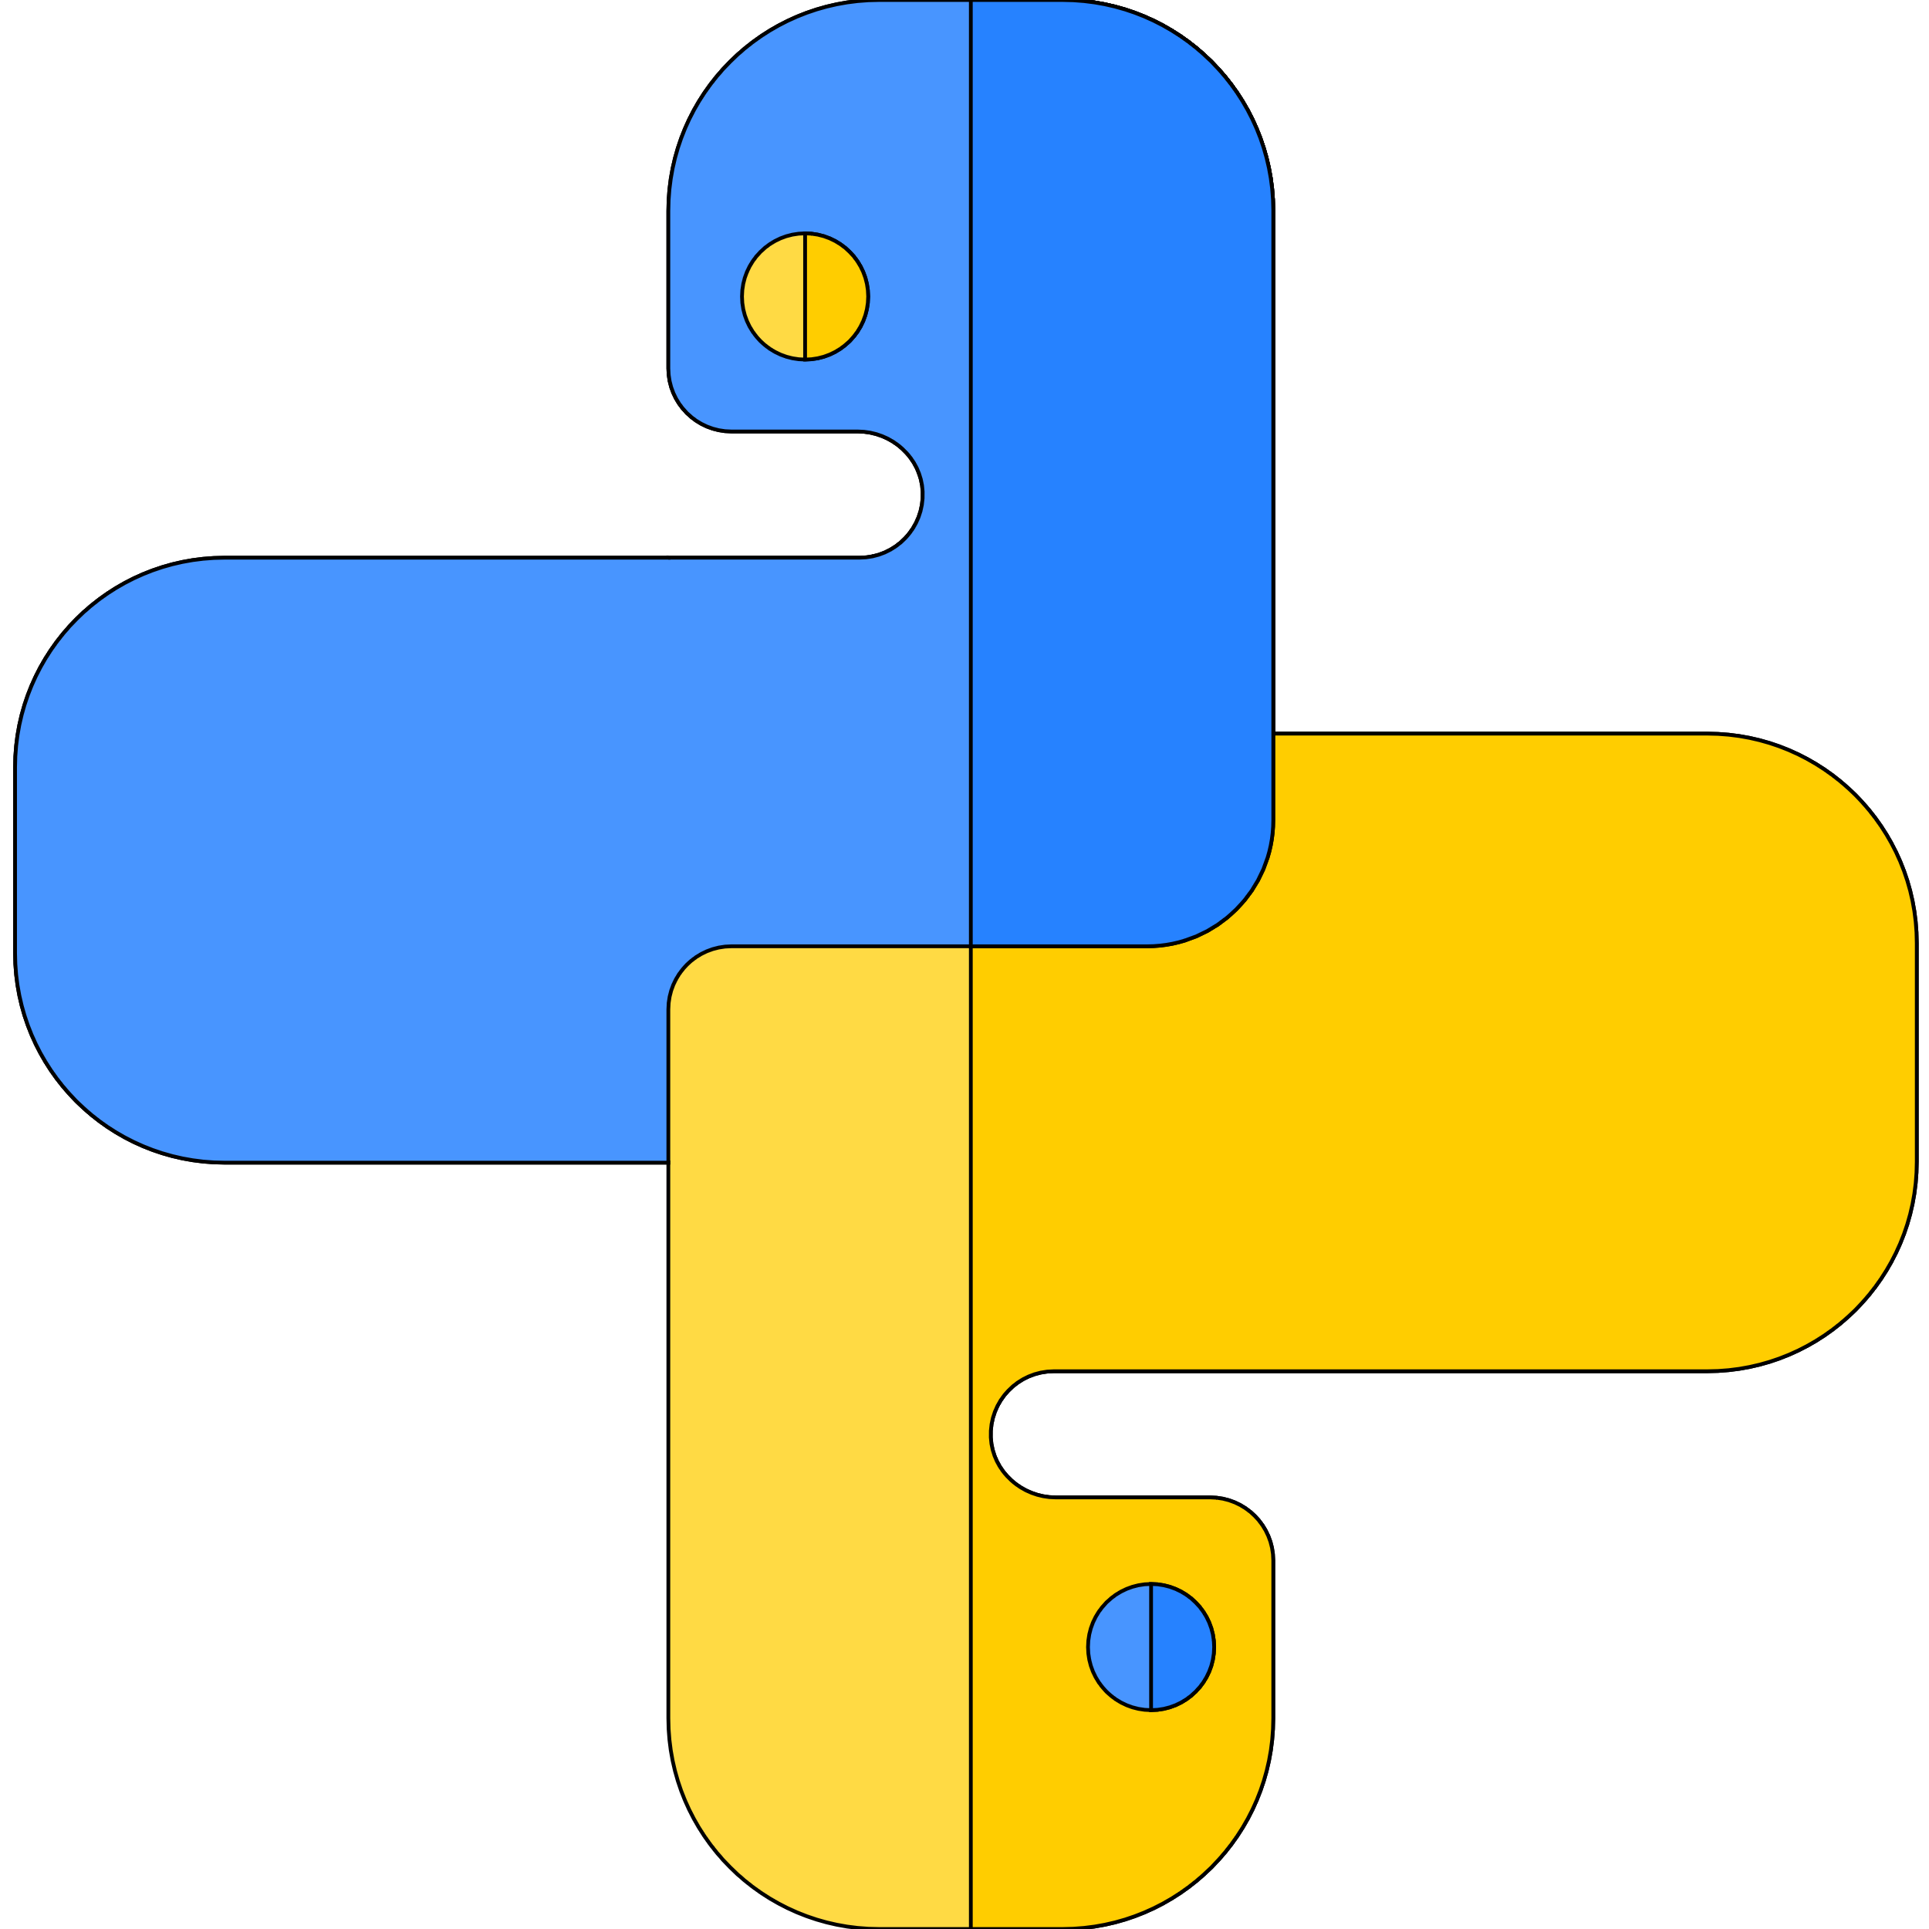
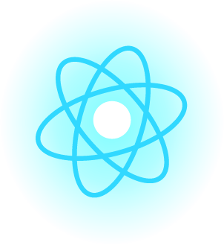

Introduction To Python
Author : Aman Singh
Lecture 1

Slide 2

Hello!
I am Aman Singh
I am here because I love to give presentations. And I want to share my knowledge with you.
You can find me at singhaman11415@gmail.com

Slide 3
Today’s Agenda
What is python programming language?
History of python.
Uses
Advantages

Slide 4
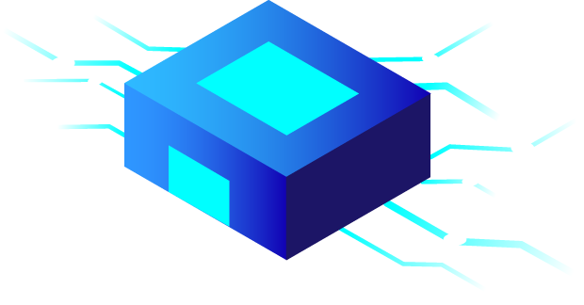

What is Python Programming Language?
?
Let’s start…

Slide 5
What is Python Programming Language?
Python is an interpreted language, that means no compiling and no linking required.
Interpreter: an interpreter is a computer program that directly executes instructions written in a programming or scripting language, without requiring them previously to have been compiled into a machine language program.
High level language
Modes : Interactive / Standard
Python 2 (legacy) / python 3 (present and future)
Beginner friendly

Slide 6
History of python
Python 3 was developed by Guido Van Rossum 1991
Launched python 2 in 2001 & python 3 in 2008
Python 3 not backward compatible
Python 2.7's end-of-life date was initially set at 2015 then postponed to 2020

Slide 7
Uses of python
Web App development
Machine learning
Artificial Intelligence
Data Science
Hacking (Favorite language b/w hackers)

Slide 8
Advantages of python
Large Community
Multipurpose and cross platform
Interpreted (best for prototyping)
User friendly
Large amount of libraries

Slide 9
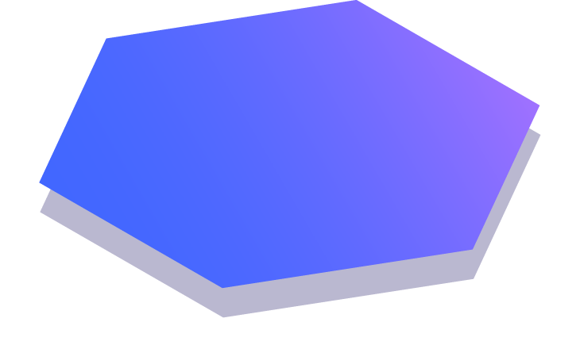
Thanks!
Any questions?
Just Comment down below.
If you like this video don’t forget to Subscribe and Share

